Slide 1


Sybex CCNA 640-802
Chapter 3: Introduction to TCP/IP
Instructor Todd Lammle

Slide 2

Chapter 2 Objectives
The CCNA Topics Covered in this chapter include:
TCP/IP and the DoD Model
  Process/Application Layer
  Host-to-Host Layer
  Internet Layer
  Network Access
IP Addressing
  Class A
  Class B
  Class C
  Private Addressing

Slide 3
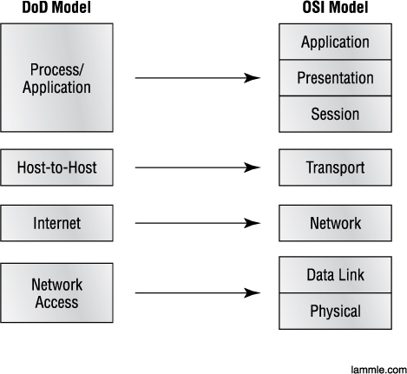
TCP/IP and the DoD Model
The figure shows a comparison of the DoD model and the OSI reference model. As you can see, the two are similar in concept, but each has a different number of layers with different names.

Slide 4
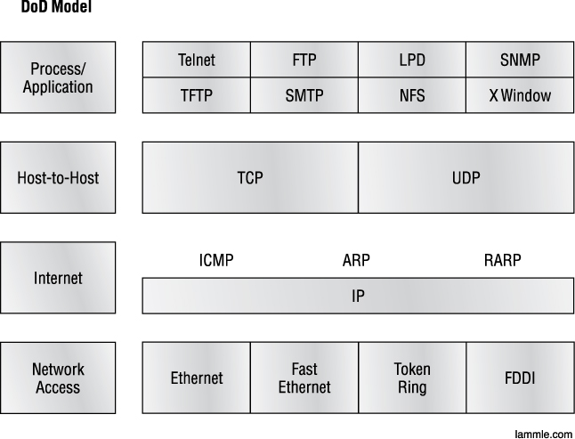
The TCP/IP Protocol Suite
The DoD and OSI models are alike in design and concept and have similar functions in similar layers.

Slide 5
Process/Application Layer
This section describes different applications and services typically used in IP networks. Some of the protocols and applications are discussed are:
  Telnet
  FTP
  TFTP
  NFS
  SMTP
  LPD
  X Window
  SNMP
  DNS
  DHCP/BootP

Slide 6

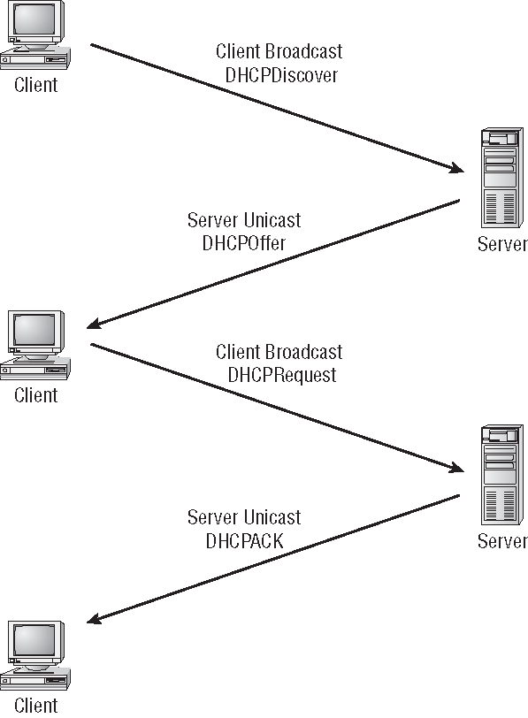
DHCP

Slide 7
Host to Host Layer
The main purpose of the Host-to-Host layer is to shield the upper-layer applications from the complexities of the network.
This layer says to the upper layer, “Just give me your data stream, with any instructions, and I’ll begin the process of getting your information ready to send.”
The following sections describe the two protocols at this layer:
  Transmission Control Protocol (TCP)
  User Datagram Protocol (UDP)

Slide 8
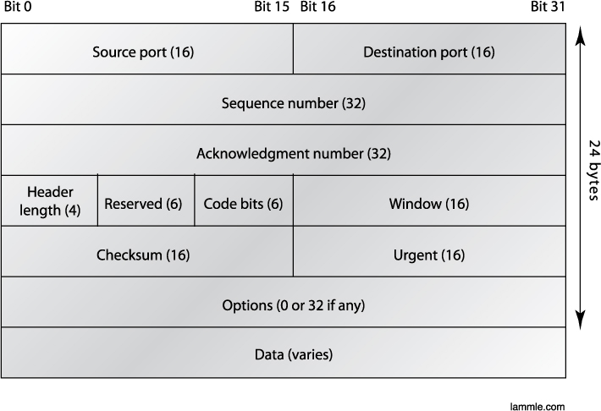
TCP
The figure shows the different fields within the TCP header.

Slide 9
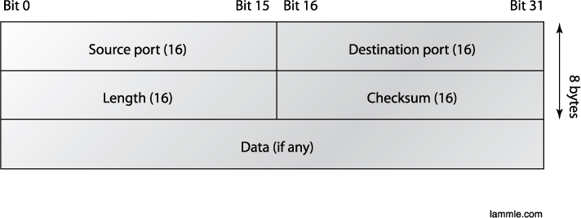
UDP
This figure clearly illustrates UDP’s markedly low overhead as compared to TCP’s hungry usage.

Slide 10
Key concepts of Host to Host Protocols
TCP UDP
Sequenced Unsequenced
Reliable Unreliable
Connection-oriented Connectionless
Virtual circuit Low overhead
Acknowledgments No acknowledgment
Windowing flow control No windowing or flow control

Slide 11
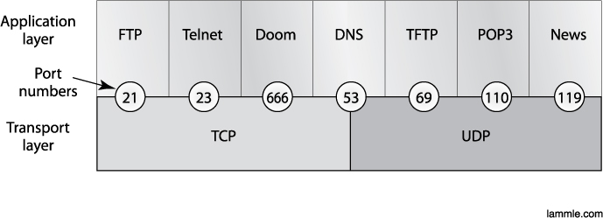
Port Numbers
Port number examples for TCP and UDP

Slide 12
Key Protocols and Port Numbers
TCP UDP
Telnet 23 SNMP 161
SMTP 25 TFTP 69
HTTP 80 DNS 53
FTP 21
DNS 53
HTTPS 443

Slide 13
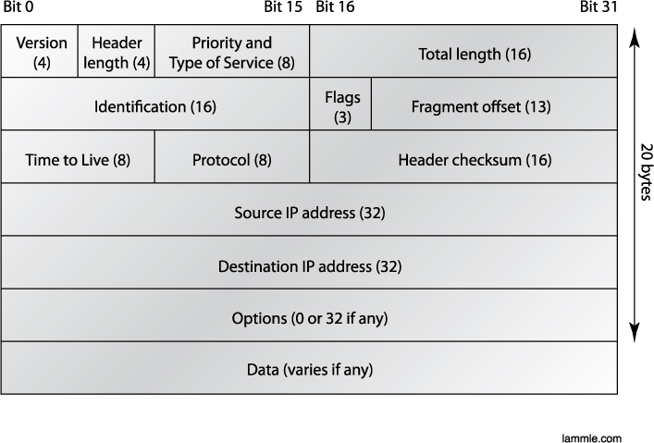
Internet Layer
IP Header

Slide 14
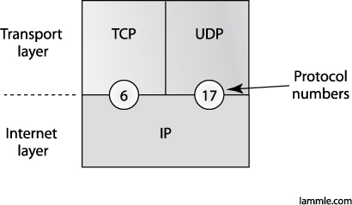
Internet Layer
Protocol Field in IP Header

Slide 15
Internet Layer
Protocol Field in IP Header
Protocol Protocol Number
ICMP 1
IP in IP (tunneling) 4
IGRP 9
EIGRP 88
OSPF 89
IPv6 41
GRE 47
Layer 2 tunnel (L2TP) 115

Slide 16
Internet Layer
ICMP
Internet Control Message Protocol (ICMP) works at the Network layer and is used by IP for many different services.
  ICMP is a management protocol and messaging service provider for IP.
  Its messages are carried as IP datagrams.
ICMP packets have the following characteristics:
  They can provide hosts with information about network problems.
  They are encapsulated within IP datagrams.

Slide 17
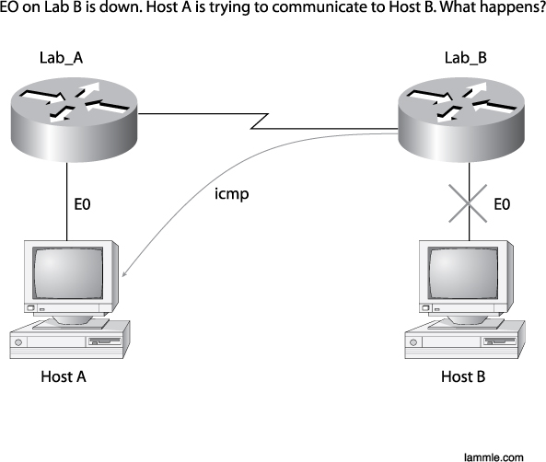
Internet Layer
ICMP
E0 of LAB_B goes down. What happens?

Slide 18
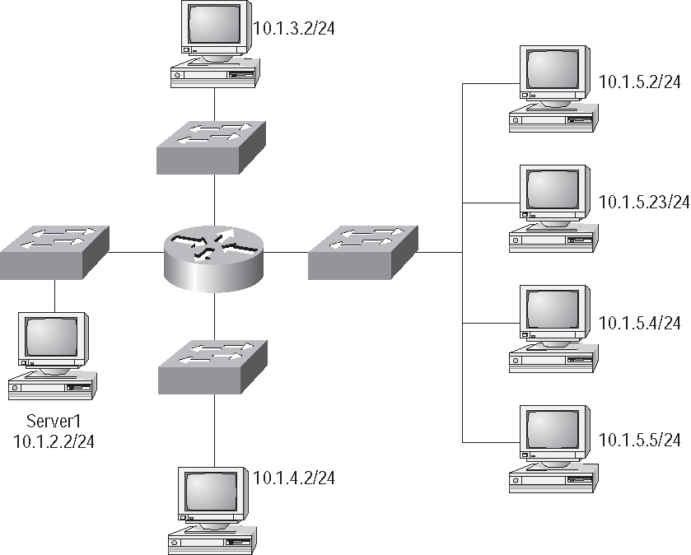
Internet Layer
ICMP In action

Slide 19
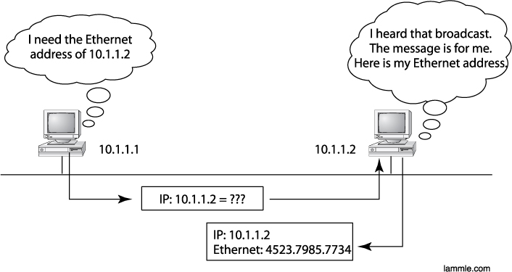
Internet Layer
ARP
ARP resolves IP addresses to Ethernet (MAC) addresses.

Slide 20
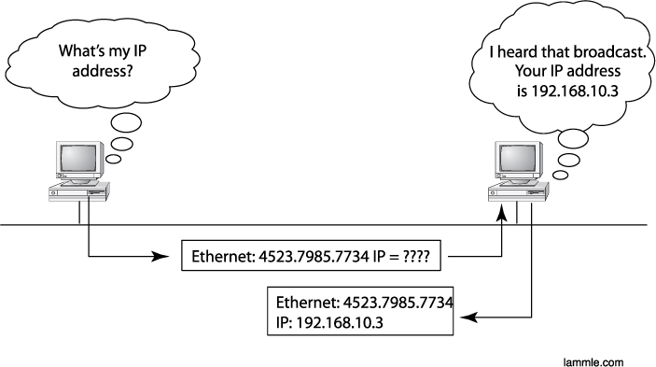
Internet Layer
RARP

Slide 21
IP Addressing
An IP address is a numeric identifier assigned to each machine on an IP network.
It designates the specific location of a device on the network.
IP addressing was designed to allow hosts on one network to communicate with a host on a different network regardless of the type of LANs the hosts are participating in.

Slide 22
IP Terminology
BIT: A bit is one digit, either a 1 or a 0.
BYTE: A byte is 7 or 8 bits, depending on whether parity is used. For the rest of this chapter, always assume a byte is 8 bits.
OCTET: An octet, made up of 8 bits, is just an ordinary 8-bit binary number. In this chapter, the terms byte and octet are completely interchangeable.
Network address: This is the designation used in routing to send packets to a remote network—for example, 10.0.0.0, 172.16.0.0, and 192.168.10.0.
Broadcast address: The address used by applications and hosts to send information to all nodes on a network is called the broadcast address.

Slide 23
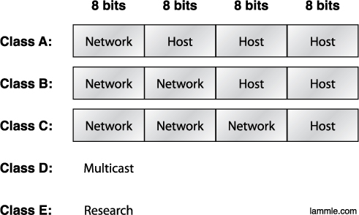
Network Addressing
Subdividing an IP address into a network and node address is determined by the class designation of one’s network. This figure summarizes the three classes of networks

Slide 24
Reserved Addressing
Address Function
Network address of all 0s Interpreted to mean “this network or segment.”
Network address of all 1s Interpreted to mean “all networks.”
Network 127.0.0.1 Reserved for loopback tests.
Node address of all 0s Interpreted to mean “network address” or any host on specified network.
Node address of all 1s Interpreted to mean “all nodes” on the specified network
Entire IP address set to all 0s Used by Cisco routers to designate the default route. Could also mean “any network.”
Entire IP address set to all 1s (same as Broadcast to all nodes on the current network; 255.255.255.255) sometimes called an “all 1s broadcast” or limited broadcast

Slide 25
Private Addressing
Address Class Reserved Address Space
Class A 10.0.0.0 through 10.255.255.255
Class B 172.16.0.0 through 172.31.255.255
Class C 192.168.0.0 through 192.168.255.255

Slide 26
IPv4 Address Types
Layer 2 broadcasts
Broadcasts (layer 3)
Unicast
Multicast

Slide 27
Written Labs and Review Questions
  Open your books and go through all the written labs and the review questions.
  Review the answers in class.

